Slide 1
The Nervous System
Rapid Communication and Control
Sensation
receives info. on environmental changes
Integration
interprets the changes, integrates signals from multiple signals
Response
induces action from of muscles or glands

Slide 2
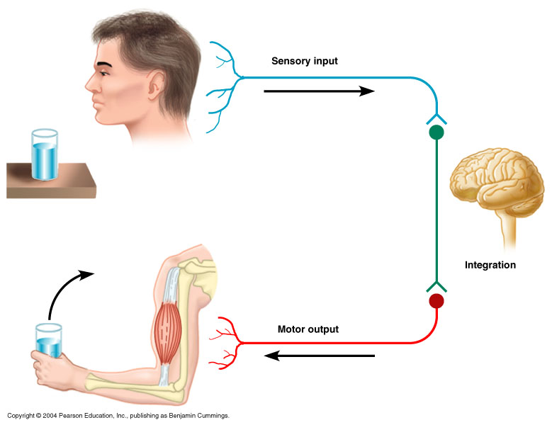
Nervous System
Functions
Sensory input – monitoring stimuli occurring inside & outside the body
Integration – interpretation of sensory input
Motor output – response to stimuli by activating effector organs
Figure 11.1

Slide 3
Nervous System Organization: General Anatomy
Central Nervous System (CNS)
Brain + Spinal Cord
control center (integration)
Peripheral Nervous System (PNS)
cranial nerves and spinal nerves
connects CNS to sensory receptors, muscles and glands

Slide 4
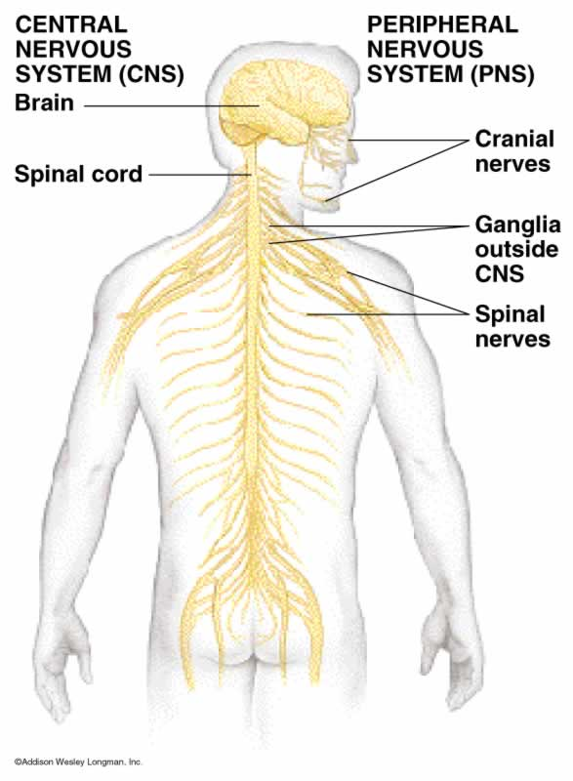
Organization of the Nervous System
Central nervous system (CNS)
Brain and spinal cord
Integration and command center
Peripheral nervous system (PNS)
Paired spinal and cranial nerves
Carries messages to and from the spinal cord and brain

Slide 5
Peripheral Nervous System: Afferent Division
Afferent (sensory) division – transmits impulses from receptors to the CNS.
Somatic afferent fibers – carry impulses from skin, skeletal muscles, and joints
Visceral afferent fibers – transmit impulses from visceral organs

Slide 6
Peripheral Nervous System: Efferent Division
Motor (efferent) division – transmits impulses from the CNS to effector organs. Two subdivisions:
Somatic nervous system – provides conscious control of skeletal muscles
Autonomic nervous system – regulates smooth muscle, cardiac muscle, and glands

Slide 7
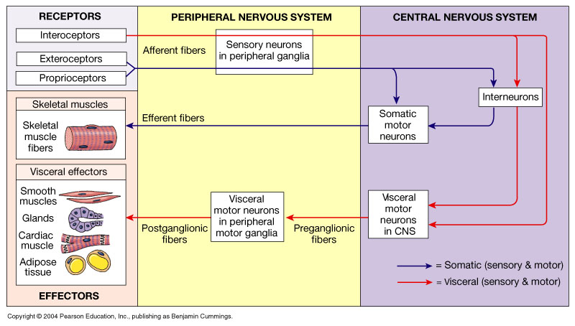
Neuron Classification
Functional:
Sensory (afferent) — transmit impulses toward the CNS
Motor (efferent) — carry impulses away from the CNS
Interneurons (association neurons) — shuttle signals through CNS pathways

Slide 8
Cell Types
Neurons
conduct electrical signals
Neuroglia
80% of all NS cells
support neurons

Slide 9
Central Nervous System
The human central nervous system (CNS) contains about 100 billion neurons.
Also contains 10–50 times this number of glial cells.
The CNS is a complex organ
About 40% of the human genes participate, at least to a degree, in its formation.
The neurons, the basic building blocks of the nervous system, have evolved from primitive neuroeffector cells that respond to various stimuli by contracting.
In more complex animals, contraction has become the specialized function of muscle cells, whereas integration and transmission of nerve impulses have become the specialized functions of neurons.

Slide 10
Cellular Elements in the CNS
Glial Cells
For many years following their discovery, glial cells (or glia) were viewed as CNS connective tissue.
Glia is Greek for glue.
However, today theses cells are recognized for their role in communication within the CNS in partnership with neurons.
Unlike neurons, glial cells continue to undergo cell division in adulthood and their ability to proliferate is particularly noticeable after brain injury (eg, stroke).
2 major types of glial cells in the vertebrate nervous system:
Microglia and Macroglia.

Slide 11
Microglia
They are scavenger cells that resemble tissue macrophages and remove debris resulting from injury, infection, and disease (eg, multiple sclerosis (a potentially disabling disease of the CNS where the immune system attacks the protective sheath (myelin) that covers nerve fibers and causes communication problems between the brain and the rest of the where it may eventually cause permanent damage or deterioration of the nerves) AIDS-related dementia, Parkinson disease, and Alzheimer disease).
Microglia arise from macrophages outside of the nervous system and are physiologically and embryologically unrelated to other neural cell types.

Slide 12
There are three types of macroglia:
Oligodendrocytes,
Schwann cells, and
Astrocytes
Oligodendrocytes and Schwann cells are involved in myelin formation around axons in the CNS and peripheral nervous system, respectively.

Slide 13
Astrocytes, which are found throughout the brain, are of two subtypes.
Fibrous astrocytes, which contain many intermediate filaments, are found primarily in white matter.
Protoplasmic astrocytes are found in gray matter and have a granular cytoplasm.

Slide 14
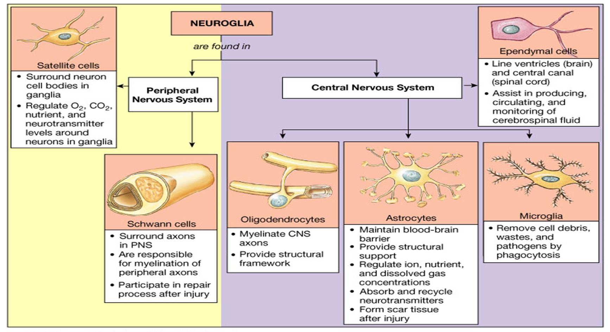

Slide 15
Both types of astrocytes send processes to blood vessels, where they induce capillaries to form the tight junctions making up the blood–brain barrier.
Also send processes that envelop synapses and the surface of nerve cells.
Protoplasmic astrocytes have a membrane potential that varies with the external K+ concentration but do not generate propagated potentials.
They produce substances that are tropic to neurons, and they help maintain the appropriate concentration of ions and neurotransmitters by taking up K+ and the neurotransmitters glutamate and gamma aminobutyrate (GABA).

Slide 16
Oligodendrocytes
I. Oligodendrocytes
Are small with relatively few processes.
Those in the white matter provide myelin, and those in the gray matter support neurons.
II Schwann cells provide myelin to the peripheral nervous system.
Each cell forms a segment of myelin sheath about 1 mm long;
The sheath assumes its form as the inner tongue of the Schwann cell turns around the axon several times, wrapping in concentric layers.
Intervals between segments of myelin are the nodes of Ranvier.

Slide 17
III. Astrocytes are the most common glia in the CNS and are characterized by their star-like shape.
They contact both capillaries and neurons and are thought to have a nutritive function.
They are also involved in forming the blood–brain barrier.

Slide 18
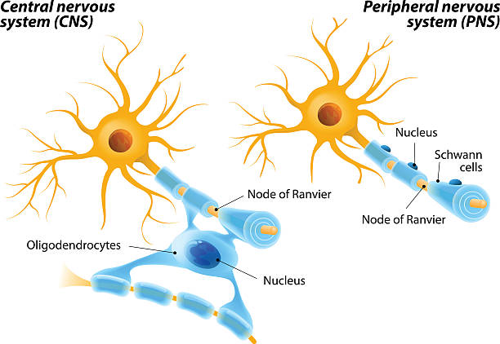

Slide 19
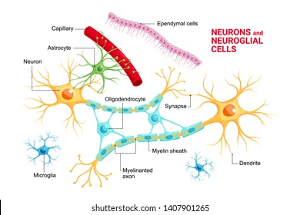

Slide 20
Neurons
Neurons in the mammalian central nervous system come in many different shapes and sizes.
Most have the same parts as the typical spinal motor neuron
The cell body (soma) contains the nucleus and is the metabolic center of the neuron.
Neurons have several processes called dendrites that extend outward from the cell body and arborize extensively.
Particularly in the cerebral and cerebellar cortex, the dendrites have small knobby projections called dendritic spines.

Slide 21
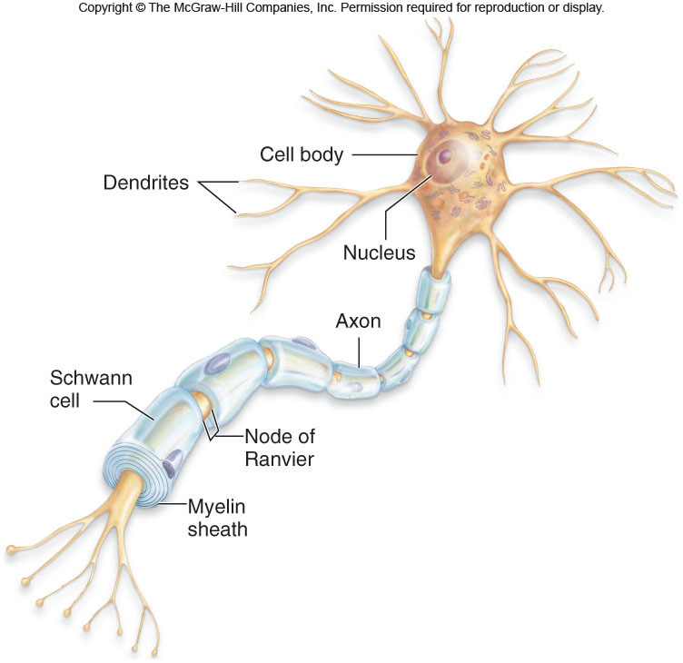
Nervous System Organization

Slide 22
A typical neuron also has a long fibrous axon that originates from a somewhat thickened area of the cell body, the axon hillock.
The first portion of the axon is called the initial segment.
The axon divides into presynaptic terminals, each ending in a number of synaptic knobs which are also called terminal buttons or boutons.

Slide 23
They contain granules or vesicles in which the synaptic transmitters secreted by the nerves are stored.
Based on the number of processes that emanate from their cell body, neurons can be classified as unipolar, bipolar, and multipolar

Slide 24
Typical Arrangement of Neural Connections
Neurons communicate via electrical signaling
They are excitable
Structurally the soma (cell body) has an extensive ER and prominent nucleoli
Long appendages or processes:
Dendrites (receive info)
Axons (deliver info); some are covered by myelin
A collection of axons is called a NERVE

Slide 25
Types of Neurons
Motor (Efferent) neuron - output
part of the PNS
transmit signals from CNS to effector tissues (muscle, gland cells)
somatic motor neurons
skeletal muscle contraction
both voluntary and reflexive
autonomic motor neurons
smooth muscle, cardiac muscle, and glands
involuntary

Slide 26
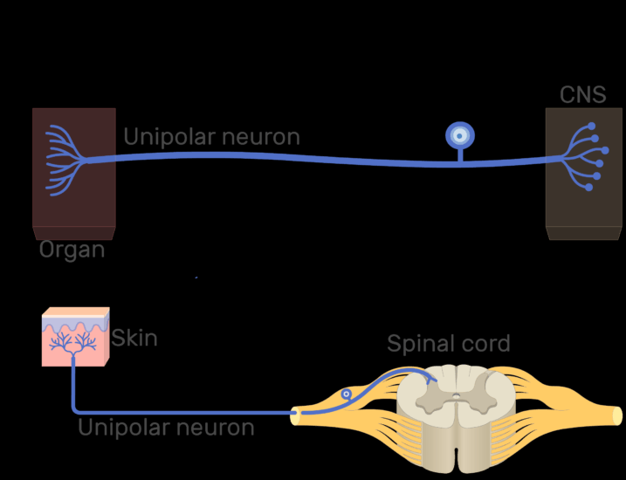
Unipolar neurons
Unipolar neurons have one process, with different segments serving as receptive surfaces and releasing terminals.

Slide 27
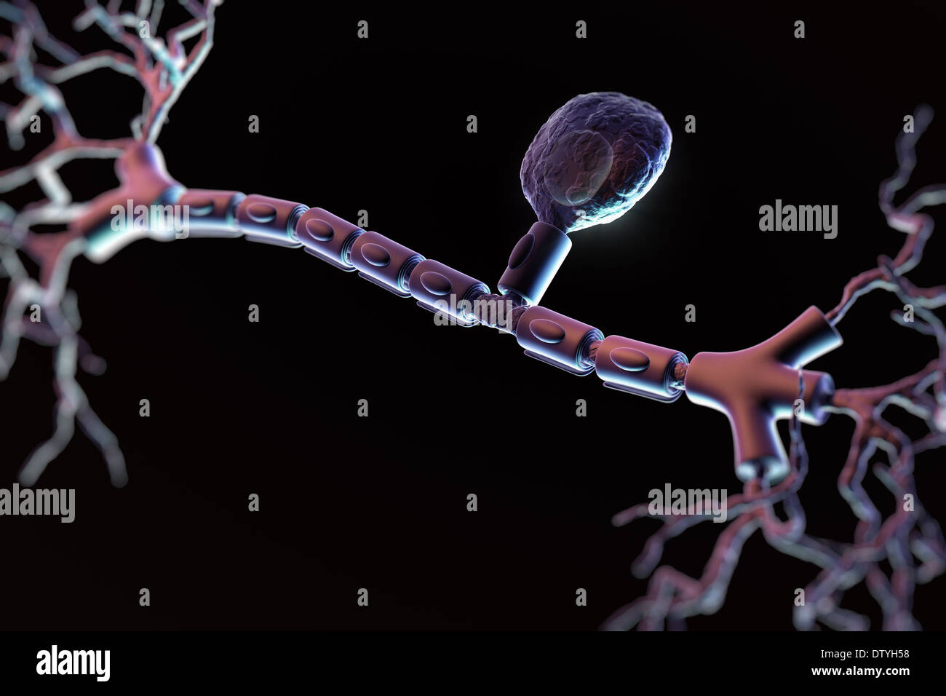
Unipolar neurons have one process, with different segments serving as receptive surfaces and releasing terminals.

Slide 28
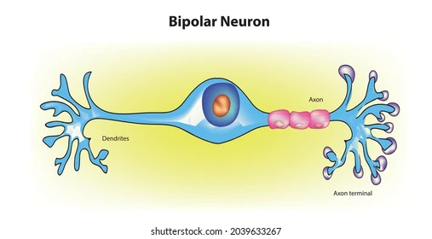
Bipolar neurons
Bipolar neurons have two specialized processes:
a dendrite that carries information to the cell and
an axon that transmits information from the cell.

Slide 29
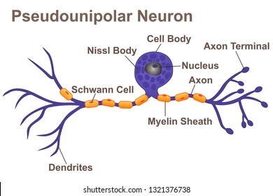
Some sensory neurons are in a subclass of bipolar cells called pseudo-unipolar cells.
As the cell develops, a single process splits into two, both of which function as axons—one going to skin or muscle and another to the spinal cord.

Slide 30

Multipolar neurons
Multipolar cells have one axon and many dendrites. Examples include motor neurons, hippocampal pyramidal cells with dendrites in the apex and base, and cerebellar Purkinje cells with an extensive dendritic tree in a single plane.

Slide 31
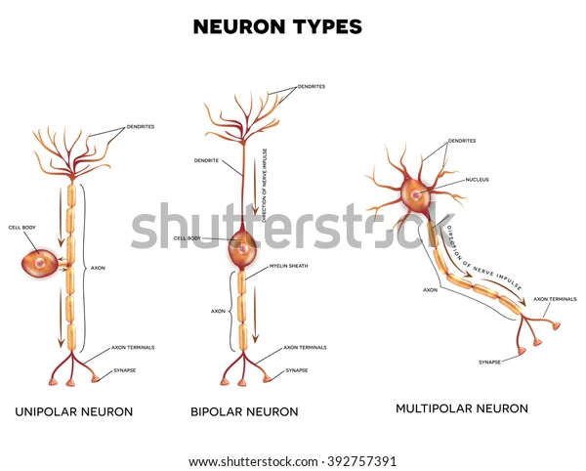

Slide 32
The conventional terminology used for the parts of a neuron works well enough for spinal motor neurons and interneurons, but there are problems in terms of "dendrites" and "axons" when it is applied to other types of neurons found in the nervous system.
Neurons generally have four important zones:
(1) a receptor, or dendritic zone, where multiple local potential changes generated by synaptic connections are integrated;

Slide 33
(2) a site where propagated action potentials are generated (the initial segment in spinal motor neurons, the initial node of Ranvier in cutaneous sensory neurons);
(3) an axonal process that transmits propagated impulses to the nerve endings; and
(4) the nerve endings, where action potentials cause the release of synaptic transmitters.

Slide 34
The cell body is often located at the dendritic zone end of the axon, but it can be within the axon (eg, auditory neurons) or attached to the side of the axon (eg, cutaneous neurons).
Its location makes no difference as far as the receptor function of the dendritic zone and the transmission function of the axon are concerned.

Slide 35
The axons of many neurons are myelinated, that is, they acquire a sheath of myelin, a protein–lipid complex that is wrapped around the axon
In the peripheral nervous system, myelin forms when a Schwann cell wraps its membrane around an axon up to 100 times

Slide 36


Slide 37
Motor neuron with a myelinated axon.
A motor neuron is comprised of a cell body (soma) with a nucleus, several processes called dendrites, and a long fibrous axon that originates from the axon hillock.
The first portion of the axon is called the initial segment.
A myelin sheath forms from Schwann cells and surrounds the axon except at its ending and at the nodes of Ranvier.
Terminal buttons (boutons) are located at the terminal endings.

Slide 38
The myelin is then compacted when the extracellular portions of a membrane protein called protein zero (P0) lock to the extracellular portions of P0 in the apposing membrane.
Various mutations in gene for P0 cause peripheral neuropathies- (damage or dysfunction of nerves that may result in numbness, tingling, muscle weakness and pain in the affected area); several different mutations have been described that cause symptoms ranging from mild to severe.

Slide 39
The myelin sheath envelops the axon except at its ending and at the nodes of Ranvier, periodic constrictions that are about 1 mm apart .
Some neurons are unmyelinated, that is, simply surrounded by Schwann cells without the wrapping of the Schwann cell membrane that produces myelin around the axon.

Slide 40
In mammalian CNS, most neurons are myelinated where myelination is by oligodendrocytes rather than Schwann cells
Unlike the Schwann cell, which forms the myelin between two nodes of Ranvier on a single neuron, oligodendrocytes emit multiple processes that form myelin on many neighboring axons.
In multiple sclerosis, a crippling autoimmune disease, patchy destruction of myelin occurs in the CNS
The loss of myelin is associated with delayed or blocked conduction in the demyelinated axons.

Slide 41
Demyelinating Diseases: 2nd Nov
Normal conduction of action potentials relies on the insulating properties of myelin.
Defects in myelin can have major adverse neurological consequences.
Eg.Multiple sclerosis (MS)
Is an autoimmune disease that affecting over 3 million people
Most common between the ages of 20 and 50 and affecting women about twice as often as men.

Slide 42
Environmental triggers include early exposure to viruses such as Epstein-Barr virus and those that cause measles, herpes, chicken pox, or influenza.
Antibodies and WBC’s attack myelin, causing inflammation and injury to the sheath and eventually the nerves that it surrounds.

Slide 43
Symptoms include : muscle weakness, fatigue, diminished coordination, slurred speech, blurred or hazy vision, bladder dysfunction, and sensory disturbances.
Progression of the disease is quite variable.
In the most common form, transient episodes appear suddenly, last a few weeks or months, and then gradually disappear.

Slide 44
Subsequent episodes can appear years later, and eventually full recovery does not occur.
Others have a progressive form of the disease in which there are no periods of remission.

Slide 45
Guillain-Barre syndrome
This is a rare disorder in which the body's immune system attacks the nerves.
Weakness and tingling in hands and feet are usually the 1st symptoms.
The sensations can quickly spread, eventually paralyzing the whole body.
In its most severe form it is a medical emergency.
Most people with the condition must be hospitalized to receive treatment
May start from the extremities working the way upwards till it reaches the respiratory muscles with resultant paralysis of respiratory muscles

Slide 46
Exact cause is unknown.
2/3 of patients report symptoms of an infection in the six weeks preceding. These include a COVID-19, respiratory or a gastrointestinal infection
No known cure but several treatments can ease symptoms and reduce the duration of the illness
Most people recover completely though severe cases can be fatal.
Recovery may take up to several years though most people are able to walk again six months after symptoms first started.
Some may have lasting effects such as weakness, numbness or fatigue.

Slide 47
There are several forms of Guillain-Barre syndrome
The main types are:
Acute inflammatory demyelinating polyradiculoneuropathy (AIDP), the most common form in North America and Europe. The most common sign of AIDP is muscle weakness that starts in the lower part of the body and spreads upward.
Miller Fisher syndrome (MFS), in which paralysis starts in the eyes. MFS is also associated with unsteady gait. Most common in Asia.
Acute motor axonal neuropathy (AMAN) and acute motor-sensory axonal neuropathy (AMSAN). Most common Asia

Slide 48
Axonal transport
Neurons are secretory cells, but they differ from other secretory cells in that the secretory zone is generally at the end of the axon, far removed from the cell body.
Protein synthesis mostly occurs in cell body
Transported to the axonal ending by axoplasmic flow.
Cell body maintains the functional and anatomic integrity of the axon; if the axon is cut, the part distal to the cut degenerates (wallerian degeneration).

Slide 49
Orthograde transport occurs along microtubules that run along the length of the axon and requires two molecular motors, dynein and kinesin
Transported from the cell body toward the axon terminals.
This transport has both fast and slow components;
Fast axonal transport occurs at about 400 mm/day, and slow axonal transport occurs at 0.5 to 10 mm/day.

Slide 50
Retrograde transport is in the opposite direction (from the nerve ending to the cell body)
Occurs along microtubules at about 200 mm/day
Synaptic vesicles recycle in the membrane, but some used vesicles are carried back to the cell body and deposited in lysosomes.
Some materials taken up at the ending by endocytosis, eg, nerve growth factor (NGF) and various viruses, are also transported back to the cell body.

Slide 51
A potentially important exception to these principles seems to occur in some dendrites.
In them, single strands of mRNA are transported from the cell body, make contact with appropriate ribosomes, and protein synthesis appears to create local protein domains.

Slide 52
Excitation and Conduction
Nerve cells have a low threshold for excitation.
Stimulus may be electrical, chemical, or mechanical.
2 types of physicochemical disturbances are produced:
Local, non-propagated potentials called synaptic or generator potentials and
Propagated potentials, the action potentials (or nerve impulses).

Slide 53
These are the only electrical responses of neurons and other excitable tissues, and they are the main language of the nervous system.
They are due to changes in the conduction of ions across the cell membrane that are produced by alterations in ion channels.
The electrical events in neurons are rapid, being measured in milliseconds (ms); and the potential changes are small, being measured in millivolts (mV).

Slide 54
The impulse is normally transmitted (conducted) along the axon to its termination.
Nerve tissue is in fact a relatively poor passive conductor, and it would take a potential of many volts to produce a signal of a fraction of a volt at the other end of a meter-long axon in the absence of active processes in the nerve.

Slide 55
Conduction is an active, self-propagating process, and the impulse moves along the nerve at a constant amplitude and velocity.
The process is often compared to what happens when a match is applied to one end of a trail of gunpowder; by igniting the powder particles immediately in front of it, the flame moves steadily down the trail to its end as it is extinguished in its progression.

Slide 56
Mammalian neurons are relatively small, but giant unmyelinated nerve cells exist in a number of invertebrate species such as in crabs and squid
The fundamental properties of neurons were first determined in these species and then found to be similar in mammals.
The neck region of the muscular mantle of the squid contains single axons up to 1 mm in diameter.
The fundamental properties of these long axons are similar to those of mammalian axons.

Slide 57
Classification of nerves
1. Depending upon structure
2. Depending upon distribution
3. Depending upon origin
4. Depending upon function
5. Depending upon secretion of neurotransmitter
6. Depending upon diameter and conduction of impulse

Slide 58
DEPENDING UPON STRUCTURE
Based on structure, nerve fibers are classified into two types:
i. Myelinated Nerve Fibers
Myelinated nerve fibers are the nerve fibers that are covered by myelin sheath.
ii. Non-myelinated Nerve Fibers
Non-­myelinated nerve fibers are the nerve fibers which are not covered by myelin sheath

Slide 59
DEPENDING UPON DISTRIBUTION
Nerve fibers are classified into two types, on the basis of distribution:
i. Somatic Nerve Fibers
Somatic nerve fibers supply the skeletal muscles of the body.
ii. Visceral or Autonomic Nerve Fibers
Autonomic nerve fibers supply the various internal organs of the body

Slide 60
DEPENDING UPON ORIGIN
On the basis of origin, nerve fibers are divided into two types:
i. Cranial Nerve Fibers
Nerve fibers arising from brain are called cranial nerve fibers.
ii. Spinal Nerve Fibers
Nerve fibers arising from spinal cord are called spinal nerve fibers.

Slide 61
DEPENDING UPON FUNCTION
Functionally, nerve fibers are classified into two types
i. Sensory Nerve Fibers
Sensory nerve fibers carry sensory impulses from different parts of the body to the central nervous system.
These nerve fibers are also known as afferent nerve fibers.
ii. Motor Nerve Fibers
Motor nerve fibers carry motor impulses from central nervous system to different parts of the body.
These nerve fibers are also called efferent nerve fibers.

Slide 62
DEPENDING UPON SECRETION OF NEUROTRANSMITTER
Depending upon the neurotransmitter substance secreted, nerve fibers are divided into two types:
i. Adrenergic Nerve Fibers
Adrenergic nerve fibers secrete noradrenaline.
ii. Cholinergic Nerve Fibers
Cholinergic nerve fibers secrete acetylcholine.

Slide 63
DEPENDING UPON DIAMETER AND CONDUCTION OF IMPULSE (ERLANGER-GASSER CLASSIFICATION)
Erlanger and Gasser classified the nerve fibers into 3 major types, on the basis of diameter (thickness) of the fibers and velocity of conduction of impulses:
i. Type A nerve fibers
ii. Type B nerve fibers
iii. Type C nerve fibers (Type IV fibers)
Among these fibers, type A nerve fibers are the thickest fibers and type C nerve fibers are the thinnest fibers.
Except type C fibers, all the nerve fibers are myelinated

Slide 64
Nerve Fiber Classification
Type | Group | Diameter (μm) | Speed (m/s) | Function
Aα | I | 12 – 20 | 72 – 120 | Muscle spindles, motor to skeletal muscles
Aβ | II | 6 – 12 | 36 – 72 | Touch, pressure, muscle spindles
Aδ | III | 1 – 6 | 6 – 36 | Pain, temperature
Aγ |  | 5 | 15 – 30 | Motor to muscle spindles
C | IV | < 1μm | 0.5 – 2 | Pain
B |  |  |  | Pre-ganglionic Autonomic nerves

Slide 65
Velocity of impulse through a nerve fiber is directly proportional to the thickness of the fiber.
Different types of nerve fibers along with diameter and velocity of conduction are given
Type A nerve fibers are divided into four types:
a. Type A alpha or Type I nerve fibers
b. Type A beta or Type II nerve fibers
c. Type A gamma nerve fibers
d. Type A delta or Type III nerve fibers.

Slide 66
Types of Nerve Fibers
Mammalian nerve fibers classified into A, B, and C groups
The A class further subdivided into α, β, γ, and δ fibers.
The greater the diameter of a nerve, the higher its conduction speed
The large axons are concerned primarily with proprioceptive sensation, somatic motor function, conscious touch, and pressure
The smaller axons concerned with pain, temperature, crude touch sensations and autonomic function.

Slide 67
Neurons can be divided into three functional classes:
afferent neurons, efferent neurons, and interneurons.
Afferent neurons convey information from the tissues and organs of the body into the central nervous system,
Efferent neurons transmit electric signals from the CNS out to effector cells (particularly muscle or gland cells or other neurons), and
Interneurons which connect neurons within the CNS system

Slide 68
For each afferent neuron entering the CNS, there are 10 efferent neurons and 200,000 interneurons.
Thus, by far most of the neurons in the CNS are interneurons
At their peripheral ends (the ends farthest from the CNS), afferent neurons have sensory receptors
This respond to various physical or chemical changes in their environment by causing electric signals to be generated in the neuron.

Slide 69
The receptor region may be a specialized portion of the plasma membrane or a separate cell closely associated with the neuron ending.
Afferent neurons propagate electric signals from their receptors into the brain or spinal cord
Afferent neurons are atypical in that they have only a single process, usually considered to be an axon.

Slide 70
One branch, the peripheral process, ends at the receptors; the other branch, the central process, enters the CNS to form junctions with other neurons.
For afferent neurons both the cell body and the long peripheral process of the axon are outside the CNS, and only a part of the central process enters the brain or spinal cord.

Slide 71
The cell bodies and dendrites of efferent neurons are within the CNS, but the axons extend out into the periphery.
The axons of both the afferent and efferent neurons, except for the small part in the brain or spinal cord, form the nerves of the peripheral nervous system.
Note that a nerve fiber is a single axon, and a nerve is a bundle of axons bound together by connective tissue

Slide 72
Interneurons lie entirely within the CNS.
Account for over 99 percent of all neurons
Have a wide range of physiological properties, shapes, and functions.
The number of interneurons interposed between certain afferent and efferent neurons varies according to the complexity of the action.
The knee-jerk reflex elicited by tapping below the kneecap has no interneurons—the afferent neurons end directly on the efferent neurons.

Slide 73
In contrast, stimuli invoking memory or language may involve millions of interneurons.
Interneurons can serve as signal changers or gatekeepers, changing, for example, an excitatory input into an inhibitory output or into no output at all.

Slide 74
Neural Growth and Regeneration
The elaborate networks of nerve-cell processes that characterize the nervous system are remarkably similar in all human beings and depend upon the outgrowth of specific axons to specific targets.
Development of the nervous system in the embryo begins with a series of divisions of precursor cells that can develop into neurons or glia.
After the last cell division, each neuronal daughter cell differentiates, migrates to its final location, and sends out processes that will become its axon and dendrites.
A specialized enlargement, the growth cone, forms the tip of each extending axon and is involved in finding out the final target for the process.

Slide 75
As axon grows, it is guided along the surfaces of other cells, most commonly glial cells.
Which particular route is followed depends largely on attracting, supporting, deflecting, or inhibiting influences exerted by several types of molecules.
Some of these molecules, such as cell adhesion molecules, reside on the membranes of the glia and embryonic neurons.
Others are soluble neurotropic factors (growth factors for neural tissue) in the extracellular fluid surrounding the growth cone or its distant target

Slide 76
Once the target of the advancing growth cone is reached, synapses are formed.
The synapses are active, however, before their final maturation occurs, and this early activity, in part, determines their final use.
During these intricate early stages of neural development, which occur during all trimesters of pregnancy and into infancy, alcohol and other drugs, radiation, malnutrition, and viruses can exert effects that cause permanent damage to the developing fetal nervous system

Slide 77
9th Nov 22
A normal, although unexpected, aspect of development of the nervous system occurs after growth and projection of the axons.
Many of the newly formed neurons and synapses degenerate.
As many as 50 to 70% of neurons die by apoptosis in some regions of the developing nervous system!
Exactly why this seemingly wasteful process occurs is unknown although neuroscientists speculate that in this way connectivity in the nervous system is refined, or “fine tuned.”

Slide 78
Although the basic shape and location of existing neurons in the mature CNS do not change, the creation and removal of synaptic contacts begun during fetal development continue, albeit at a slower pace, throughout life as part of normal growth, learning, and aging.
Division of neuron precursors is largely complete before birth, and after early infancy new neurons are formed at a slower pace to replace those that die.
Severed axons can repair themselves, however, and significant function regained, provided that the damage occurs outside the central nervous system and does not affect the neuron’s cell body.

Slide 79
After repairable injury, the axon segment now separated from the cell body degenerates.
The proximal part of the axon (the stump still attached to the cell body) then gives rise to a growth cone, which grows out to the effector organ so that in some cases function is restored.

Slide 80
In contrast, severed axons within the CNS attempt sprouting, but no significant regeneration of the axon occurs across the damaged site, and there are no well-documented reports of significant function return.
Either some basic difference of CNS neurons or some property of their associated with nearby glia, prevents their functional regeneration.
In humans, however, spinal injuries typically crush rather than cut the tissue, leaving the axons intact.
In this case, a primary problem is self-destruction (apoptosis) of the nearby oligodendroglia, because when these cells die and their associated axons lose their myelin coat, the axons cannot transmit information effectively

Slide 81
Synaptic transmission

Slide 82
There are 2 types of synapses: electric and chemical.
At electric synapses, the plasma membranes of the pre- and postsynaptic cells are joined by gap junctions
These allow the local currents resulting from arriving AP’s to flow directly across the junction through the connecting channels in either direction from one neuron to the neuron on the other side of the junction, depolarizing the membrane to threshold thus initiating an AP in the 2nd.
Electric synapses rare in the mammalian nervous system and mostly found in cardiac and smooth muscles
Most common are chemical synapses

Slide 83
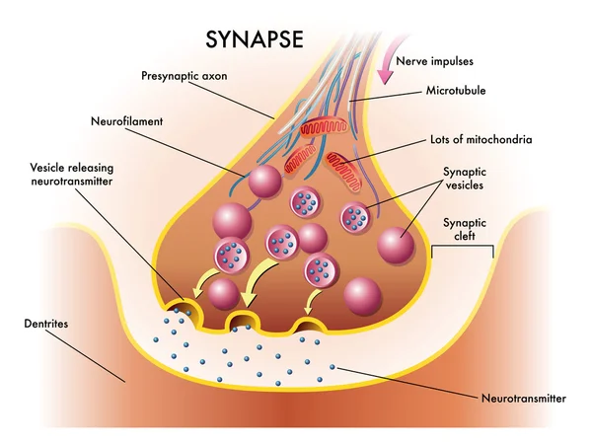

Slide 84
Synapses
FUNCTIONS OF SYNAPSE
Main function of the synapse is to transmit the
impulses, i.e. action potential from one neuron to
another.
However, some of the synapses inhibit these
Impulses hence impulses are not transmitted to the
postsynaptic neuron.

Slide 85
On the basis of functions, synapses are divided into two types:
1. Excitatory synapses, which transmit the impulses
(excitatory function)
2. Inhibitory synapses, which inhibit the transmission
of impulses (inhibitory function).

Slide 86
EXCITATORY FUNCTION
Excitatory Postsynaptic Potential
Excitatory postsynaptic potential (EPSP) is the non-propagated electrical potential that develops during the process of synaptic transmission.
When the action potential reaches the presynaptic axon terminal, the Voltage gated calcium channels at the presynaptic membrane are opened

Slide 87
.The calcium ions enter the axon terminal from ECF
Calcium ions cause the release of neurotransmitter substance from the vesicles by means of exocytosis.
Neurotransmitter, which is excitatory in function (excitatory neurotransmitter) passes through presynaptic membrane and synaptic cleft and reaches the postsynaptic membrane

Slide 88
CONT…
.The neurotransmitter binds with receptor protein present in postsynaptic membrane to form neurotransmitter-receptor complex.
Neurotransmitter receptor complex causes production of a non-propagated EPSP.
Common excitatory neurotransmitter in a synapse is acetylcholine.

Slide 89
Mechanism of Development of EPSP
Neurotransmitter-receptor complex causes opening of ligand gated Na+ channels.
The Na+ ions from ECF enter the cell body of postsynaptic neuron.
As the sodium ions are positively charged, RMP inside the cell body is altered and mild depolarization develops.
This type of mild depolarization is called EPSP.
It is a local potential (response) in the synapse.

Slide 92
Properties of EPSP
EPSP is confined only to the synapse.
It is a graded potential similar to receptor potential.
EPSP has two properties:
1. It is non propagated
2. It does not obey all or none law

Slide 93
Significance of EPSP
EPSP is not transmitted into the axon of postsynaptic neuron.
However, it causes development of action potential in the axon.
When EPSP strong enough, causes the opening of voltage gated sodium channels in the initial segment of axon.
Due to the entrance of sodium ions, the depolarization occurs in the initial segment of axon and thus, the AP develops.
From here, the AP spreads to other segment of the axon.

Slide 94
Inhibitory Function
Postsynaptic or Direct Inhibition
Postsynaptic inhibition is the type of synaptic inhibition that occurs due to the release of an inhibitory neurotransmitter from presynaptic terminal instead of an excitatory neurotransmitter substance.
Also called direct inhibition.
Inhibitory neurotransmitters are gamma aminobutyric acid (GABA), dopamine and glycine.

Slide 95
Action of GABA
Development of inhibitory postsynaptic potential
Inhibitory postsynaptic potential (IPSP) is the electrical potential in the form of hyperpolarization that develops during postsynaptic inhibition.
Inhibitory neurotransmitter substance acts on postsynaptic membrane by binding with receptor.
Transmitter receptor complex opens the ligand gated potassium channels instead of sodium channels.

Slide 96
CONT…
The K+ ions, which are available in plenty in the cell body of postsynaptic neuron move to ECF.
Simultaneously, chloride channels also open and chloride ions (which are more in ECF) move inside the cell body of postsynaptic neuron.
The exit of potassium ions and influx of chloride ions cause more negativity inside, leading to hyperpolarization.
Hyperpolarized state of the synapse inhibits synaptic transmission

Slide 98
CONT…

Slide 99
Refractory period
During the AP, a 2nd stimulus, no matter how strong, will not produce a second AP
The membrane is said to be in its absolute refractory period.
Occurs since the voltage-gated Na channels enter a closed, inactive state at the peak of the AP
Membrane must repolarize before the Na channel can be open.
After absolute refractory period, there is an interval during which a second action potential can be produced, but only if the stimulus strength is considerably greater than usual.
Is the relative refractory period, and lasts 10 to 15 ms or longer in neurons
Occurs during hyperpolarization.

Slide 100
If a depolarization exceeds the increased threshold or outlasts the relative refractory period, additional action potentials will be fired.
The refractory periods limit the number of AP’s that can be produced by an excitable membrane in a given period of time.
Also increase reliability of neural signaling because they help limit extra impulses.
Most nerve cells respond at frequencies of up to 100 AP’s per sec

Slide 101
Presynaptic or Indirect Inhibition:
Presynaptic inhibition occurs due to the failure of presynaptic axon terminal to release sufficient quantity of excitatory neurotransmitter substance.
It is also called indirect inhibition.
Presynaptic inhibition is mediated by axoaxonal synapses.
Prominent in spinal cord and regulates propagation of information to higher centers in brain.

Slide 102
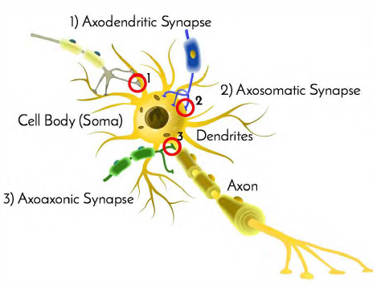

Slide 103
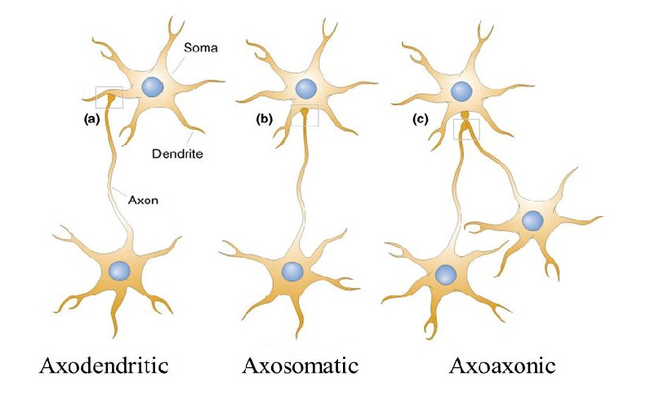

Slide 104
CONT…
Normally, during synaptic transmission, action potential reaching the presynaptic neuron causes development of EPSP’s in the postsynaptic neuron.
But, in spinal cord, a modulatory neuron called presynaptic inhibitory neuron forms an axoaxonic synapse with the presynaptic neuron
This inhibitory neuron inhibits the presynaptic neuron and decreases the magnitude of action potential in presynaptic neuron.

Slide 105
The smaller action potential reduces calcium influx.
This in turn decreases the quantity of neurotransmitter released by presynaptic neuron.
The magnitude of EPSP in postsynaptic neuron is decreased resulting in synaptic inhibition

Slide 106
Spatial summation
Excitation of a single presynaptic terminal on the surface of a neuron almost never excites the neuron
Because single terminal causes EPSP of only about 0.5 – 1mv instead of the 20 – 30 required to reach threshold
Many synapses usually stimulated at same time and this effects summate to reach threshold

Slide 107
Temporal summation
Each time a presynaptic terminal fires, the released transmitter substance opens the membrane channels for at most a millisecond or so.
This changed postsynaptic potential lasts up to 15 milliseconds after the synaptic membrane channels have already closed.
A second opening of the same channels can increase the postsynaptic potential to a still greater level

Slide 108
The more rapid the rate of stimulation, the greater the postsynaptic potential becomes.
Thus, successive discharges from a single presynaptic terminal, if they occur rapidly enough, can add to one another; that is, they can “summate.”
This is temporal summation

Slide 109
Fatigue of Synaptic Transmission
When excitatory synapses are repetitively stimulated at a rapid rate, no. of discharges by postsynaptic neuron very high at first, but rate becomes progressively less in succeeding milliseconds or seconds.
This is fatigue
Important as in case of epileptic seizures where fatigue subdues the seizures finally
Is protective mechanism against excess neuronal activity

Slide 110
Mainly due to exhaustion of transmitter substance pre-synaptically
Could also be due to:
(1) progressive inactivation of many of the postsynaptic membrane receptors
(2) slow development of abnormal concentrations of ions inside the postsynaptic neuronal cell.

Slide 111
Effect of Acidosis or Alkalosis
PH affects neuronal transmission highly
Alkalosis increases excitability highly
PH of 7.8 – 8 often causes seizures
Acidosis decreases excitability
In very severe diabetic patients, coma will develop

Slide 112
Effect of Hypoxia
Neuronal excitability highly dependent on an adequate oxygen supply.
Cessation of oxygen for only a few seconds can cause complete in-excitability of some neurons.
Observed when the brain’s blood flow is temporarily interrupted, because within 3 to 7 seconds the person becomes unconscious

Slide 113
Effect of Drugs
Many drugs increase or decrease the excitability of neurons
Caffeine, theophylline, and theobromine, found in coffee, tea, and cocoa respectively, all increase neuronal excitability mostly by decreasing threshold
Most anesthetics increase threshold for excitation thus decreasing synaptic transmission at many points in the nervous system

Slide 114
Synaptic delay
During transmission of a neuronal signal from a presynaptic neuron to a postsynaptic neuron, a certain amount of time is consumed in the process of
(1) discharge of the transmitter substance by the presynaptic
terminal,
(2) diffusion of the transmitter to the postsynaptic neuronal membrane,
(3) action of the transmitter on the membrane receptor,

Slide 115
(4) action of the receptor to increase the membrane permeability, and
(5) inward diffusion of sodium to raise the excitatory postsynaptic potential to a high enough level to elicit an action potential.
The minimal period of time required for all these events to take place, even when large numbers of excitatory synapses are stimulated simultaneously, is about 0.5 millisecond.
This is synaptic delay.

Slide 116
NEUROTROPHINS
For trophic support of neurons
Some proteins, referred to as neurotrophins, have been found to be necessary for survival and growth of neurons
Some are products of the muscles or other structures that the neurons innervate whereas others are produced by astrocytes.
They bind to receptors at the endings of a neuron,, are then internalized and then transported by retrograde transport to the neuronal cell body
Here cause production of proteins associated with neuronal development, growth, and survival.

Slide 117
Other neurotrophins are produced in neurons and transported anterogradely to the nerve ending, where they maintain the integrity of the postsynaptic neuron.
The neurons have receptors for the neutrophins for the uptake into neuron
One of the most important is the Nerve Growth Factor

Slide 118
Nerve growth factor
It is a protein growth factor necessary for the growth and maintenance of sympathetic neurons and some sensory neurons.
Made up of two α, two β, and two γ subunits.
It is picked up by neurons in the extracerebral organs they innervate
Transported in retrograde fashion from the endings of the neurons to their cell bodies.

Slide 119
NGF also present in the brain
Appears to be responsible for the growth and maintenance of cholinergic neurons in the basal forebrain and striatum.
Injection of antiserum against NGF in newborn animals leads to near total destruction of the sympathetic ganglia
there is evidence that the maintenance of neurons by NGF is due to a reduction in apoptosis (programmed cell death)

Slide 120
Others include Brain-derived neurotrophic factor (BDNF), neurotrophin 3 (NT-3), NT-4/5 which again help in reduction of apoptosis among other effects
Schwann cells and astrocytes produce ciliary neurotrophic factor (CNTF).
It promotes the survival of damaged and embryonic spinal cord neurons
May prove to be of value in treating human diseases in which motor neurons degenerate

Slide 121
Chemical transmission at synapse
Nerve endings have been called biological transducers that convert electrical energy into chemical energy.
This conversion process involves
i. The synthesis of the transmitter agents,
ii. The storage of neurotransmiter in synaptic vesicles, and
iii. The release of NT by the nerve impulses into the synaptic cleft.
iv. The NT acting on appropriate receptors on postsynaptic membrane
v. Rapid removal of the NT the synaptic cleft.

Slide 122
All these processes, plus the postreceptor events in the postsynaptic neuron, are regulated by many physiologic factors and can be altered by drugs.
Therefore, interventions can be done to alter nerve function in any one of the steps involved in synaptic transmission as we will find out later

Slide 123
A great majority of drugs that act on the nervous system do so by altering synaptic mechanisms and thus synaptic effectiveness.
All the synaptic mechanisms in earlier slide are vulnerable.
Long-term effects of drugs are sometimes difficult to predict because the imbalances produced by the initial drug action are soon counteracted by feedback mechanisms that normally regulate the processes.
EG: If a drug interferes with the action of a NT by inhibiting its synthesis, the neurons may respond by increasing the rate of precursor transport into the axon terminals to maximize the use of any enzyme that is available.

Slide 124
Drugs that bind to a receptor and produce a response similar to the normal activation of that receptor are called agonists, and drugs that bind to the receptor but are unable to activate it are antagonists.
By occupying the receptors, antagonists prevent binding of the normal neurotransmitter when it is released at the synapse.
Specific agonists and antagonists can affect receptors on both pre- and postsynaptic membranes.
Diseases can also affect synaptic mechanisms.

Slide 125
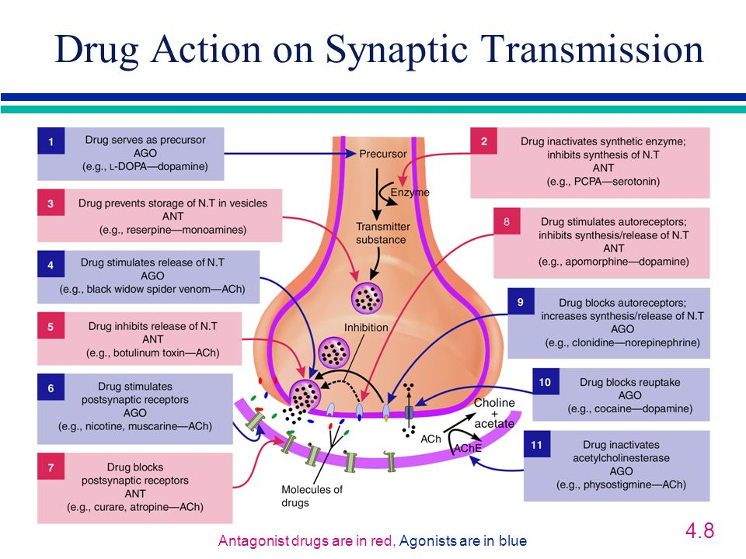

Slide 126
Neurotransmiters
Acetylcholine Acetylcholine (ACh) is synthesized from choline and acetyl coenzyme A in the cytoplasm of synaptic terminals and stored in synaptic vesicles.
After release, activates receptors on the postsynaptic membrane
Inactivated (metabolized) by the enzyme acetylcholinesterase located on the pre- and postsynaptic membranes
Choline released during inactivation taken up into presynaptic axon for synthesis of new ACh.
The ACh concentration at the receptors is also reduced by simple diffusion away from the site

Slide 127
Found in both peripheral and CNS
Receptors in brain are important in cognitive functions.
Some play major role in attention, learning, and memory by reinforcing the ability to detect and respond to meaningful stimuli.
Degeneration of this neurons common in people with Alzheimer’s disease, a brain disease that is usually age-related and is the most common cause of declining intellectual function in late life, affecting 10 to 15 percent of people over age 65, and 50 percent of people over age 85.

Slide 128
Because of the degeneration of cholinergic neurons, this disease is associated with a decreased amount of ACh in certain areas of the brain and even the loss of the postsynaptic neurons that would have responded to it.
These defects and those in other neurotransmitter systems that are affected in this disease are related to the declining language and perceptual abilities, confusion, and memory loss that characterize Alzheimer’s victims.
The exact causes of this degeneration are unknown

Slide 129
Biogenic Amines
Are neurotransmitters that are synthesized from amino acids and contain an amino group (R–NH2).
Most common are dopamine, norepinephrine, serotonin, and histamine and epinephrine
Catecholamines
Dopamine, norepinephrine (NE), and epinephrine referred to as catecholamines.
Formed from amino acid tyrosine and share the same basic synthetic pathway
Synthesis and release from the presynaptic terminals strongly modulated by autoreceptors on the presynaptic terminals.

Slide 130
After activation of the receptors on the postsynaptic cell, the NT is decreased by
Active transport into the presynaptic axon terminal.
Metabolism by enzymes at terminal mostly by monoamine oxidase and Catechol –o- methyl transferase
Monoamine oxidase inhibitors, which increase the brain extracellular concentration of the catecholamine neurotransmitters, are used in the treatment of diseases such as depression
In the CNS play essential roles in states of consciousness, mood, motivation, directed attention, movement, blood-pressure regulation among others

Slide 131
Serotonin
Produced from amino acid tryptophan
Its effects generally have a slow onset, indicating that it works as a neuromodulator.
Serotonin releasing neurons innervate virtually every structure in the brain and spinal cord and operate via at least 16 different receptor types.
In general, it has an excitatory effect on pathways that are involved in the control of muscles, and an inhibitory effect on pathways that mediate sensations.

Slide 132
The activity of serotonergic neurons is lowest or absent during sleep and highest during states of alert wakefulness.
In addition to their contributions to motor activity and sleep also involved in
Regulation of food intake (depresses appetite),
Reproductive behavior (activation reduces sexual behavior), and
Emotional states such as mood and anxiety (low levels associated with emotional disorders).

Slide 133
Amino Acid Neurotransmitters
Several amino acids function as neurotransmitters.
Are by far the most prevalent neurotransmitters in CNS
EXCITATORY AMINO ACID NT’s
Glutamate and aspartate, serve as neurotransmitters at most of excitatory synapses in the CNS
In fact, most excitatory synapses in the brain release glutamate.
The excitatory amino acids function in learning, memory, and neural development.
Also implicated in epilepsy, Alzheimer’s and Parkinson’s diseases, and the neural damage that follows strokes, brain trauma, and other conditions of low oxygen availability

Slide 134
INHIBITORY Amino Acid NT’s
GABA (gamma-aminobutyric acid) and Glycine are the major inhibitory neurotransmitters in the CNS
Drugs such as Valium that reduce anxiety, guard against seizures, and induce sleep enhance the action of GABA.

